Slide 1
Software Engineering COMP 201
Lecturer: Sebastian Coope
Ashton Building, Room G.18
E-mail: coopes@liverpool.ac.uk
COMP 201 web-page:
http://www.csc.liv.ac.uk/~coopes/comp201
Lecture 2 – Software Processes

Slide 2
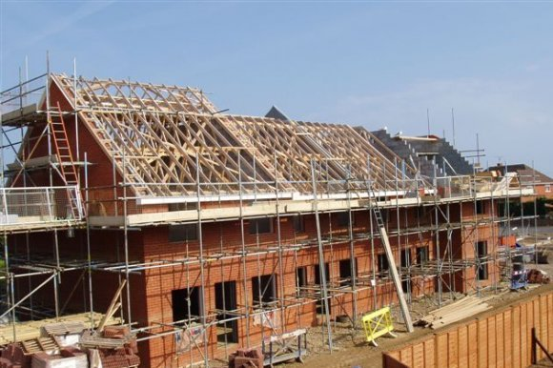
Processes (building a house)

Slide 3
Tasks
What to build?
Where to build?
How much money?
Get the money
Design the build (Detailed plans, timescales etc.)
Get permissions?
Start with foundations
Build up from foundations
Fully test everything
When basic structure complete, make sure it is looks right
Show to customer
Re-adjust to customer’s feedback

Slide 4
Questions?
Does the previous list apply to Software?

Slide 5
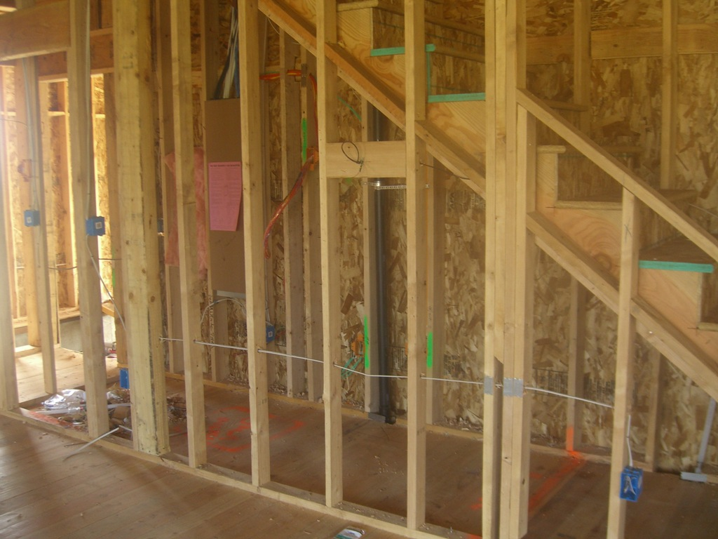
Task order (early fix is easy)

Slide 6
What is a Process … ?
When we provide a service or create a product we always follow a sequence of steps to accomplish a set of tasks
You do not usually
put up the drywall before the wiring for a house is installed or
bake a cake before all the ingredients are mixed together
We can think of a series of activities as a process
During this lecture we shall see some examples of software development processes that are used to ensure software is developed in a systematic way using tried and tested techniques

Slide 7
What is a Process … ?
Any process has the following characteristics
It prescribes all of the major activities (what to do)
It uses resources and produces intermediate and final products (what is made)
It may include sub-processes and has entry and exit criteria (detailed work flow)
The activities are organized in a sequence
when to do it
Constraints or controls may apply to activities
(budget constraints, availability of resources , etc.)

Slide 8
Process Building development
Architect
Design
house
Get
Planning permission
Secure
funding
(re)Draw plans
(re)Specify build
Site survey
Plans/
specifications

Slide 9
Software Processes
When the process involves the building of some product we refer to the process as a life cycle
Software development process – software life cycle
Coherent sets of activities for
Specifying,
Designing,
Implementing and
Testing software systems

Slide 10
Processes and software
Software (unlike buildings/bridges etc.)
Can be changed at anytime
Is often required to change often after construction
Benefits
Software can be improved almost without limit
Leading to problems
Software often gets faults as it evolves
Software cost is hard to manage
Problems with user’s experience and expectations
Software complexity grows exponentially with size (not linear)

Slide 11
Software Process Models
The Waterfall Model (classic engineering, example bridge building)
Separate and distinct phases of specification and development
Evolutionary Development (more like product engineering)
Specification and development are interleaved
Agile and Scrum
Used widely in industry today

Slide 12
Waterfall Model
The drawback of the waterfall model is the difficulty of accommodating change after the process is underway

Slide 13
Waterfall Model Problems
Inflexible partitioning of the project into distinct stages
This makes it difficult to respond to changing customer requirements
Therefore, this model is only appropriate when the (final) requirements are well-understood (rare in software)
Waterfall model describes a process of stepwise refinement
Based on hardware engineering models
Widely used in military and aerospace industries

Slide 14
Reality check!
Practically no one in industry follows the waterfall method as shown exactly here to produce software
Why bother, then?
Each stage is an important step in software development
It’s easy to remember
The sequence is important
Spec. before Design
Design before coding etc.
Many industry practises could do with improvement!

Slide 15
Evolutionary Development
Rather than using the waterfall model we may use Evolutionary development which is based upon the idea of developing an initial implementation , exposing it to the user and refining it based upon their response.
Exploratory development
Objective is to work with customers and to evolve a final system from an initial outline specification.
Should start with well-understood requirements.
The system evolves by adding new features as they are proposed by customer.
Evolutionary development involves Exploratory development

Slide 16
Evolutionary Development

Slide 17
Evolutionary Development
Problems
Lack of process visibility
Systems are sometimes poorly structured
Applicability
All types of system but rare in safety critical

Slide 18
Reality check
In reality all modern development has a degree of evolutionary development BUT is hybrid (see SCRUM later)
Sometimes the specification is mostly completed at the start and then added to as the project proceeds
The evolution cycles pre-determined
500 use cases
In phase 1 develop code use cases 1-50
In phase 2 develop use cases 51-100
In phase 3 develop use cases 101-200
In phase 4 develop use cases 201-500

Slide 19
Agile development
Lightweight approach to software development
Example include Scrum and XP
Focused on
Code development as code activity
Test driven development (tests developed before code)
Often use pair programming
Iterative development
Self-organised teams (people sign up for tasks)

Slide 20
Incremental Development (Scrum)
Rather than deliver the system as a single delivery, the development and delivery is broken down into increments (SCRUM sprints) with each increment delivering part of the required functionality
User requirements are prioritised and the highest priority requirements are included in early increments
Once the development of an increment is started, the requirements are frozen though requirements for later increments can continue to evolve

Slide 21
Incremental Development Advantages
Customer value can be delivered with each increment so system functionality is available earlier
Early increments act as a prototype to help elicit requirements for later increments
Lower risk of overall project failure
The highest priority system services tend to receive the most testing

Slide 22
In Reality
Most software processes involve
Prototyping
Iterative building
Why
It reduces risk of making the wrong product
It allows the software to undergo more testing
It produces working product as we go along, so less chance of inventory loss

Slide 23
Process is context dependent
Nuclear power station/air traffic control
Highly formalised processes
Detailed testing specifications
Web development for small website
Prototyping
Web development for large website
SCRUM development, storyboarding

Slide 24
Final question
The specification is by a long margin
The MOST critical phase of any software engineering project
Why?

Slide 25
Lecture Key Points
Software processes are the activities involved in producing and evolving a software system. They are represented in a software process model
General activities are specification, design and implementation, validation and evolution
Generic process models describe the organisation of software processes
Iterative process models describe the software process as a cycle of activities

